Slide 1
BST: Binary Search Tree
More methods
Kurt Friedrich
Spring 2015

Slide 2
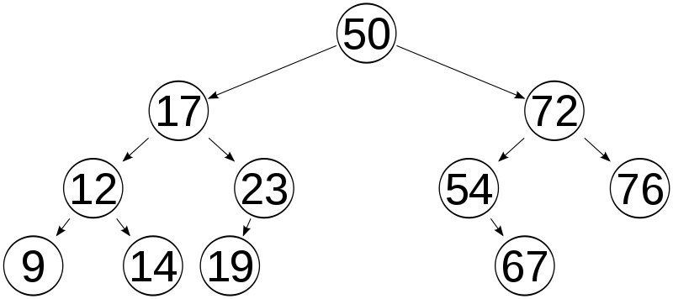
BST: Binary Search Tree
bstTop
L
R
L
R
L
R
L
R
L
R
L
R
L
R
L
R
L
R
L
R
L
R
L
LeftNode Ref
R
RightNode Ref
bstTop (all 3 are of type node objets)

Slide 3
2-RecAdd Program
Already have methods to add new node
public void Add(int keyParam)
And to find a node by its keyParam
public bool Find(int targetKey)
Adding 2 new methods that use recursion:
Add new node using recursion
public void AddRec(int keyParam)
Find using recursion
public bool FindRec(int target)
Both of these methods in our BST class are very short, but they rely on recursive methods that are implemented inside of the BSTnode internal class

Slide 4
Sample BST
bstTop
Top
Node
50
Left Node
Right Node
17
72
Left Node
Right Node
Left Node
Right Node
12
23
54
76
Left Node
Right Node
Left Node
Null
Null
Right Node
Left Node
Null
9
14
19
67
Null
Null
Null
Null
Null
Null
Left Node
Right Node
13
Null
Null
New node to be added

Slide 5
Sample BST - adding node 13
bstTop
Top
Node
50
Left Node
Right Node
Iteration loop
17
Current
Left Node
Right Node
Use Current object to access
the node’s data as we walk down
Cur key
Cur L pt
Cur R pt
12
Left Node
Right Node
13
Null
Null
9
14
New node to be added
Null
Null
Null
Null

Slide 6
Sample BST - adding node recursion 13
bstTop
RM
RM
Top
Node
50
Left Node
Right Node
RM
17
Left Node
Right Node
Each node has a method, which
calls that same method in the next node
Each node object has the code to insert
a new node and fix the pointers
RM
12
Left Node
Right Node
13
Null
Null
9
14
New node to be added
Null
Null
Null
Null

Slide 7
add new node at location using recursive approach
public void AddRec(int keyParam)
{
if (bstTop == null) // deal with an empty BST
{
bstTop = new BSTnode(keyParam);
// add a new node in the bstTop position
return;
// LeftNode and RightNode will default to
}
else
{
bstTop.AddRec_BSTnode(keyParam);
// call method in BSTnode bstTOP object
// to do the job
}
}

Slide 8
find node using recursive approach
public bool FindRec(int target)
{
if (bstTop == null) // deal with an empty BST
{
return false; // can't be here if are none
}
else // call recursive method in BSTnode class
{
return bstTop.FindRec_BSTnode(target);
// call method in BSTnode bstTOP object
// to do the job
}
}

Slide 9
Look at the 2-RecAdd-Find pgm

Slide 10
Sample BST
bstTop
Top
Node
50
Left Node
Right Node
17
72
Left Node
Right Node
Left Node
Right Node
12
23
54
76
Left Node
Right Node
Left Node
Null
Null
Right Node
Left Node
Null
9
14
19
67
Null
Null
Null
Null
Null
Null
Left Node
Right Node
13
Null
Null
New node to be added

